Slide 1

Machine Learning Support Vector Machines(SVM) By K. Igwe 2021

Slide 2
Lesson Objectives
Introduction
Linear Discriminant
Linearly Separable Case
Linearly Non Separable Case
Non-Linear Discriminant
Kernel Trick(Not covered in this course)

Slide 3
Support Vector Machines (SVM)
Linear Discriminant
Linearly Separable Case
Linearly Non Separable Case
Kernel Trick
Non Linear Discriminant

Slide 4
Linear Separation
For example if you want to distinguish between cats and dogs you could use features that include height and weight.
Off course many features could be used to distinguish between a cat and dog such as different facial features, paw size, jaw shape, etc.
Each feature will be represented by a different dimension.
Thus three features will be three dimensional and 10 features will be ten dimensional.
However support vector machines only support two dimensionally plotted data

Slide 5
Linear Separation
When looking at your graph you can draw a straight line arbitrarily to split your data into two classes.

Slide 6
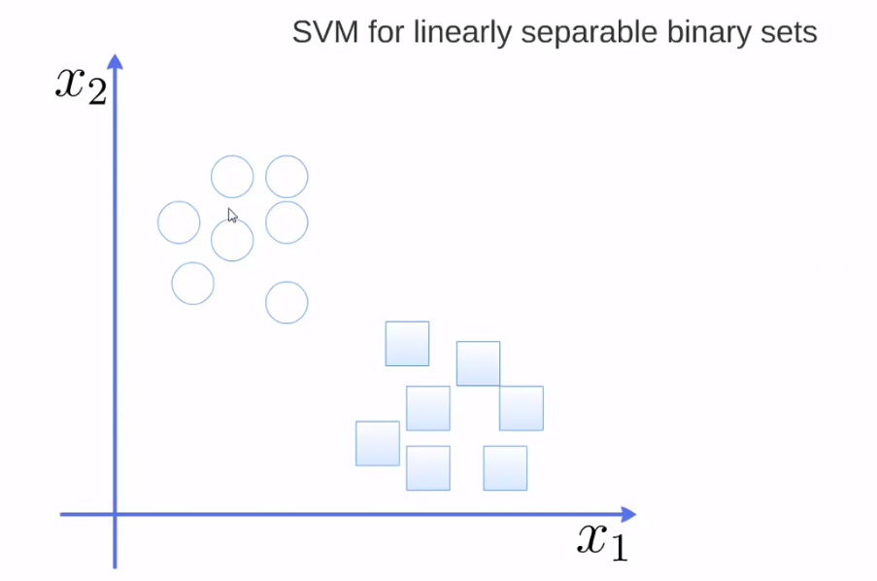

Slide 7
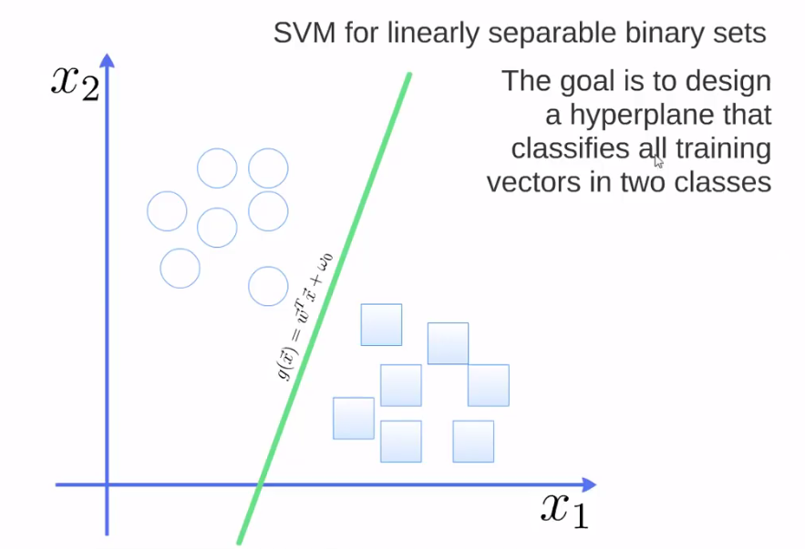

Slide 8
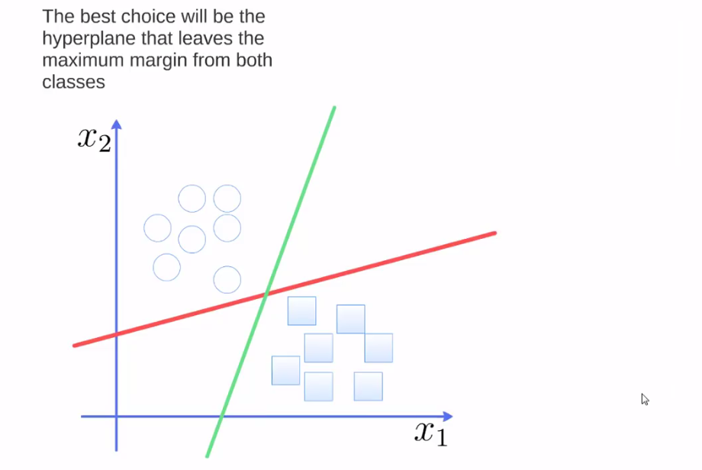

Slide 9
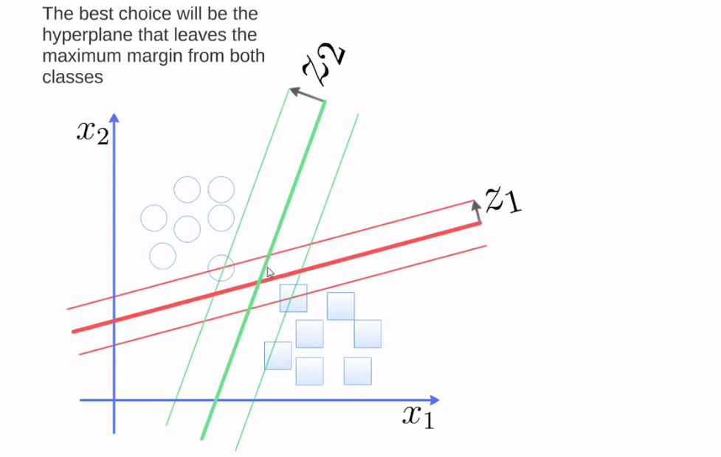

Slide 10
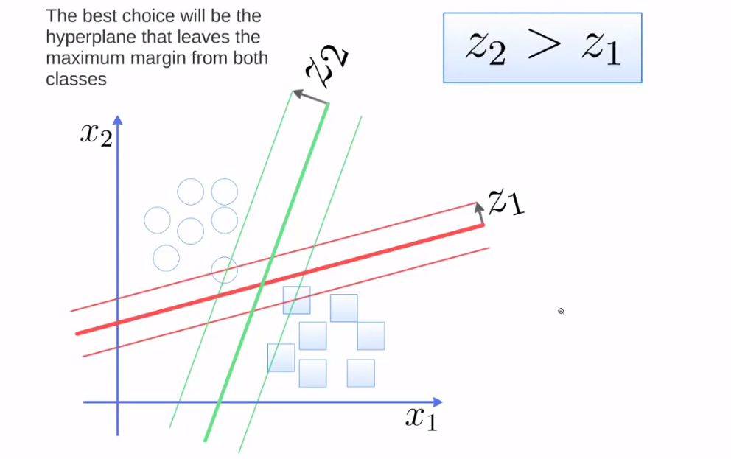

Slide 11

Hyperplane Function
$g\left(\vec{x}\right)={\vec{w}}^{T}\vec{x}+ω_{0}$

Slide 12
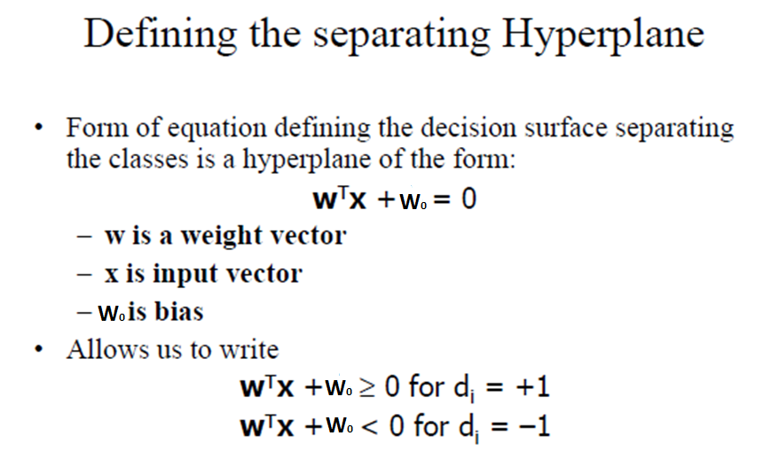

Slide 13
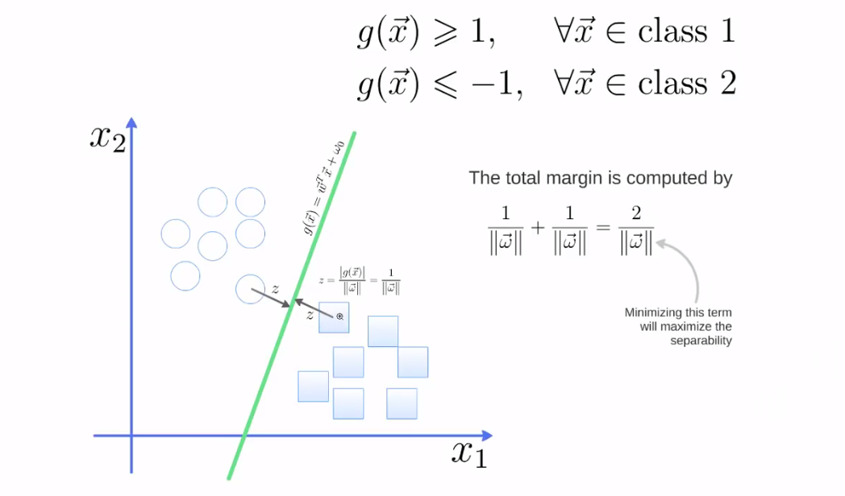

Slide 14
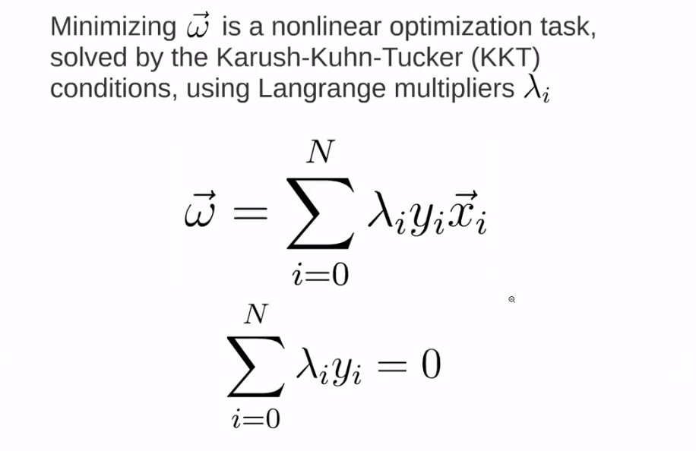

Slide 15
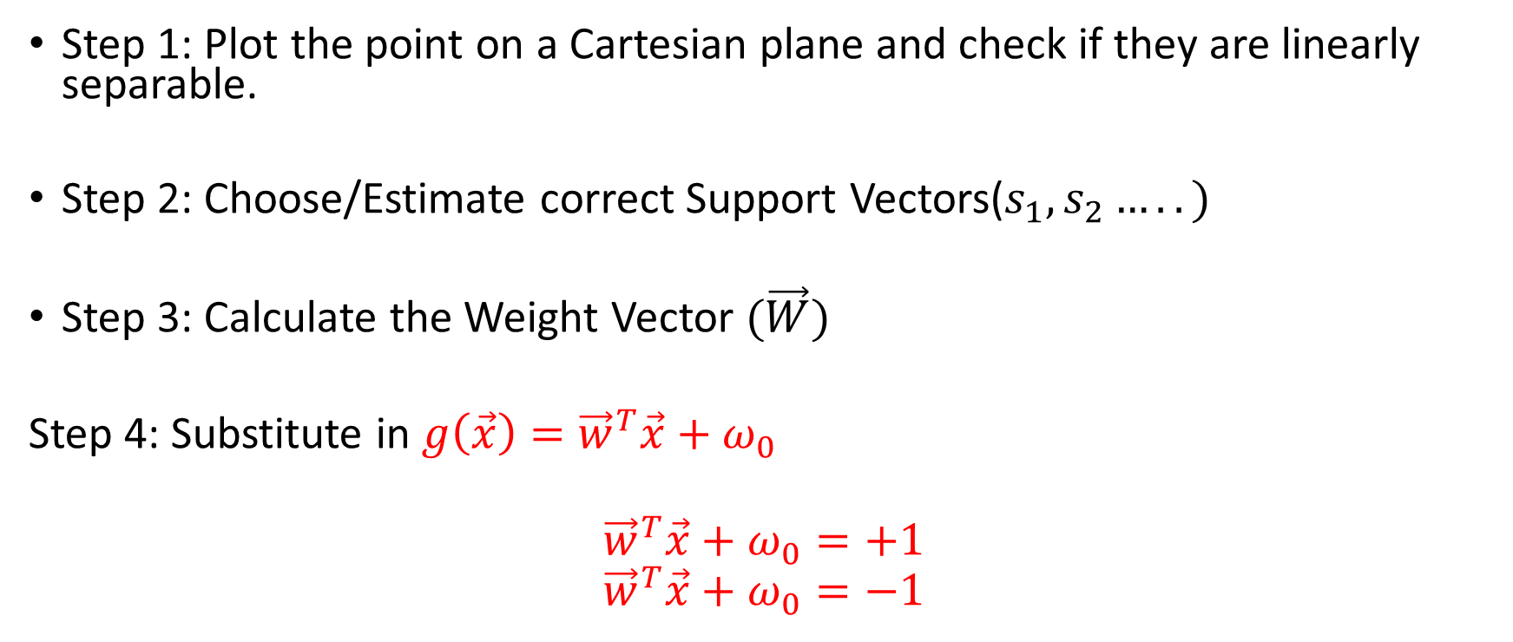
Steps To Calculate HP function
Step 1: Plot the point on a Cartesian plane and check if they are linearly separable.
Step 2: Choose/Estimate correct Support Vectors($s_{1},s_{2}…..)$
Step 3: Calculate the Weight Vector $(\vec{W})$
Step 4: Substitute in $g\left(\vec{x}\right)={\vec{w}}^{T}\vec{x}+ω_{0}$
$${\vec{w}}^{T}\vec{x}+ω_{0}=+1$$
$${\vec{w}}^{T}\vec{x}+ω_{0}=−1$$

Slide 16
Support Vectors
These are the vector point from the two classes, which are closer to each other and
Support vectors are data points that are closer to the hyperplane and influence the position and orientation of the hyperplane.
Using these support vectors, we maximize the margin of the classifier.
Deleting the support vectors will change the position of the hyperplane.
These are the points that help us build our SVM.
S1, S2, S3,……

Slide 17

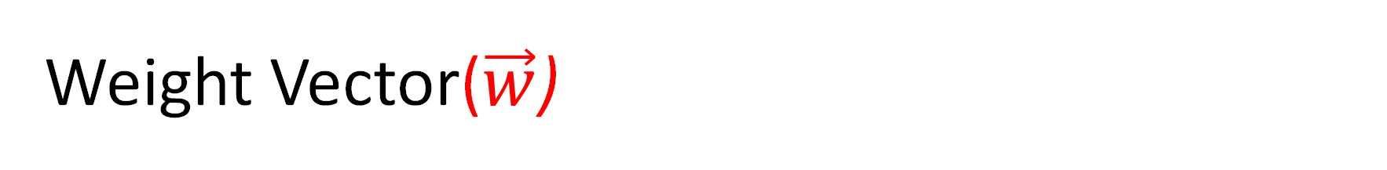
Weight Vector($\vec{w}$)
$\vec{w}=a({\vec{s}}_{1}−{\vec{s}}_{2})$
Is a parallel vector between the chosen support vectors.

Slide 18
Example
X1(Feature) | X2(Feature) | Class
2 | 3 | A
1 | 1 | B
2 | 0 | B

Slide 19
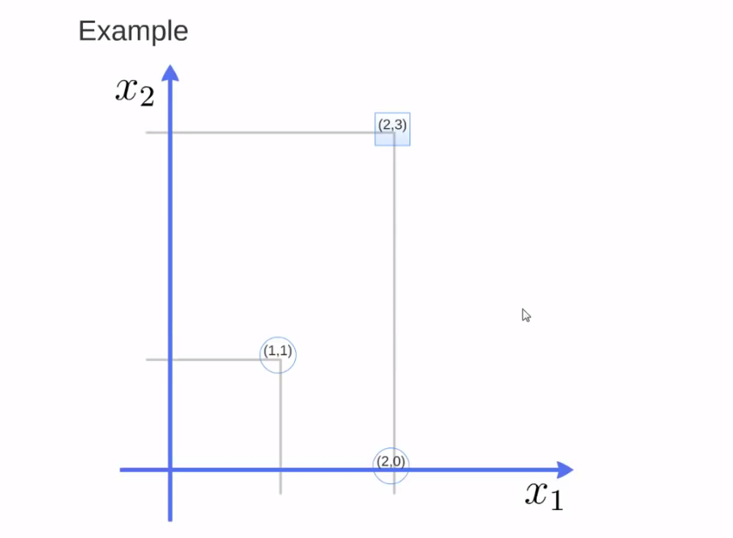

Slide 20
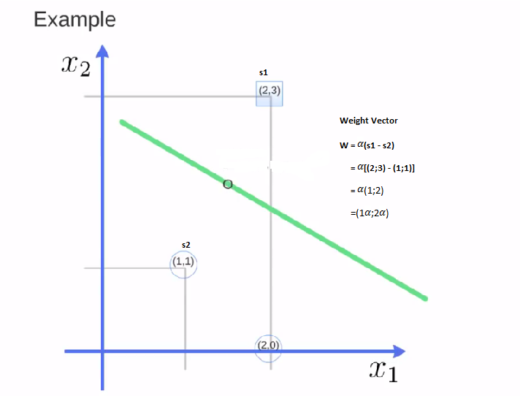

Slide 21
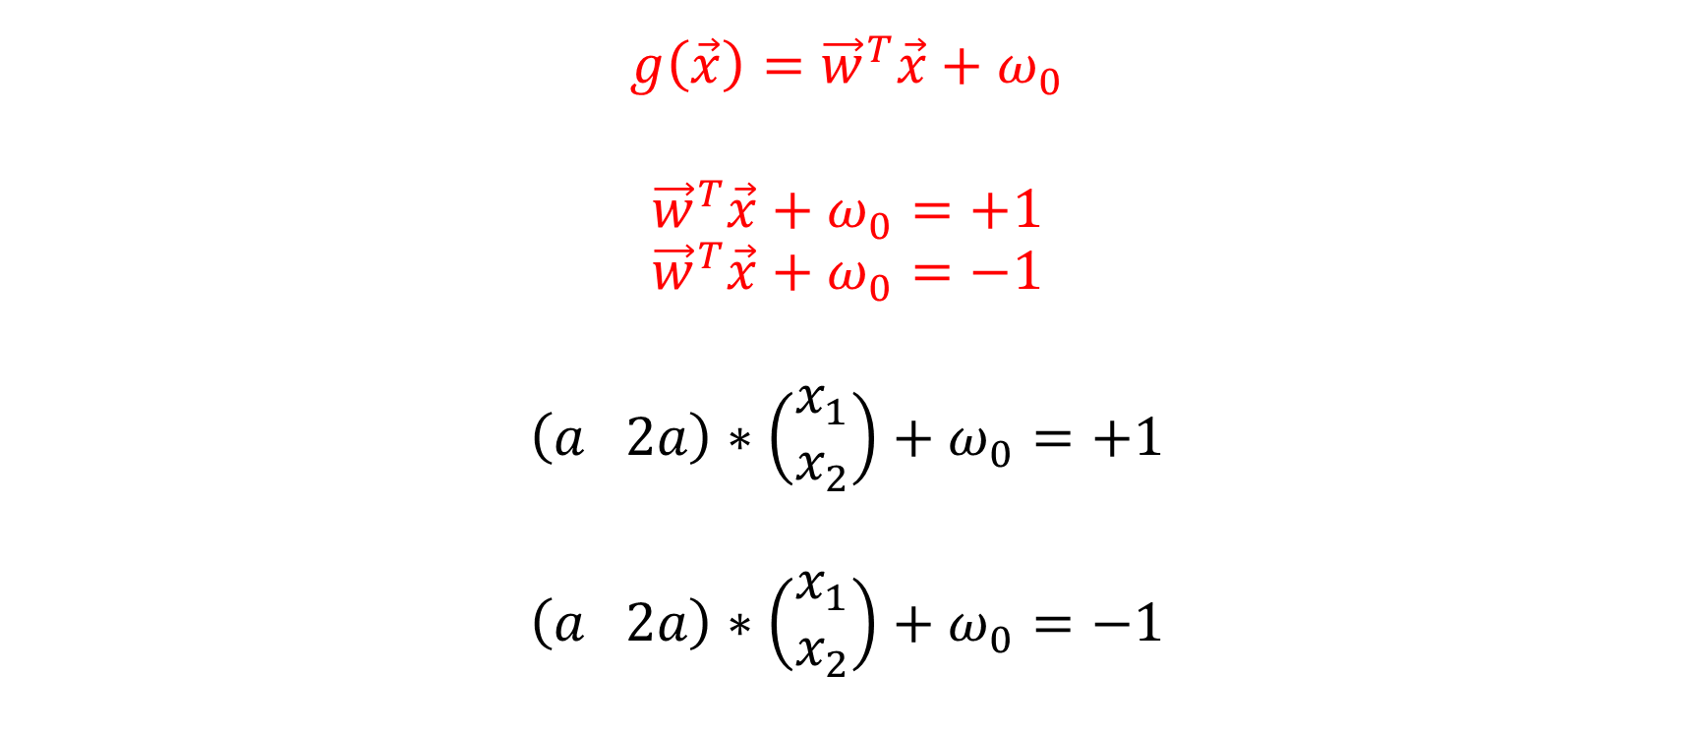
Using the weight Vector Points
$$g\left(\vec{x}\right)={\vec{w}}^{T}\vec{x}+ω_{0}$$
$${\vec{w}}^{T}\vec{x}+ω_{0}=+1$$
$${\vec{w}}^{T}\vec{x}+ω_{0}=−1$$
$$\left(a 2a\right)∗\left(\begin{matrix}x_{1} \\ x_{2}\end{matrix}\right)+ω_{0}=+1$$
$$\left(a 2a\right)∗\left(\begin{matrix}x_{1} \\ x_{2}\end{matrix}\right)+ω_{0}=−1$$

Slide 22


Substitution
$$\left(a 2a\right)∗\left(\begin{matrix}2 \\ 3\end{matrix}\right)+ω_{0}=+1$$
$$\left(a 2a\right)∗\left(\begin{matrix}1 \\ 1\end{matrix}\right)+ω_{0}=−1$$

Slide 23

Solve Simultaneously
$2a+6a+ω_{0}= 1$ ….. *
$a+2a+ω_{0}=−1$ ……**

Slide 24

Solve Simultaneously
8$a+ω_{0}= 1$ ….. *
$3a+ω_{0}=−1$ ……**
By elimination:
$5a=2$
$$a=\frac{2}{5}$$

Slide 25
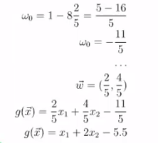
Substitute for omega

Slide 26

Using the weight Vector Points
$$g\left(\vec{x}\right)={\vec{w}}^{T}\vec{x}+ω_{0}$$
$$g\left(x\right)=\left(\frac{2}{5} ; \frac{4}{5} \right)∗\left(\begin{matrix}x_{1} \\ x_{2}\end{matrix}\right)+ω_{0}$$
$$g\left(\vec{x}\right)=\frac{2}{5}x_{1}+\frac{4}{5}\vec{x_{2}}−\frac{11}{5}$$
$$0=\frac{2}{5}x_{1}+\frac{4}{5}\vec{x_{2}}−\frac{11}{5}$$
$$0=$$
$$x_{1}+2\vec{x_{2}}−\frac{11}{2}=0$$
$${g\left(x\right)=x}_{1}+2\vec{x_{2}}−\frac{11}{2}$$

Slide 27
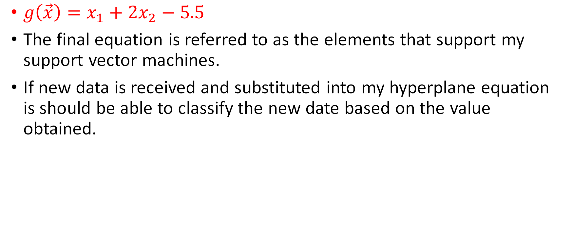
classification
$g\left(\vec{x}\right)=x_{1}+2x_{2}−5.5$
The final equation is referred to as the elements that support my support vector machines.
If new data is received and substituted into my hyperplane equation is should be able to classify the new date based on the value obtained.

Slide 28
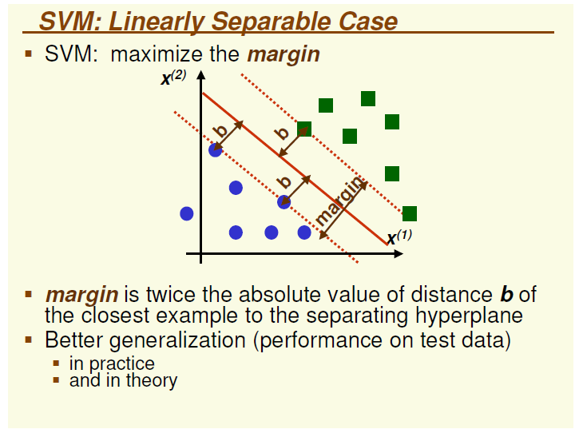
Margin(m)

Slide 29
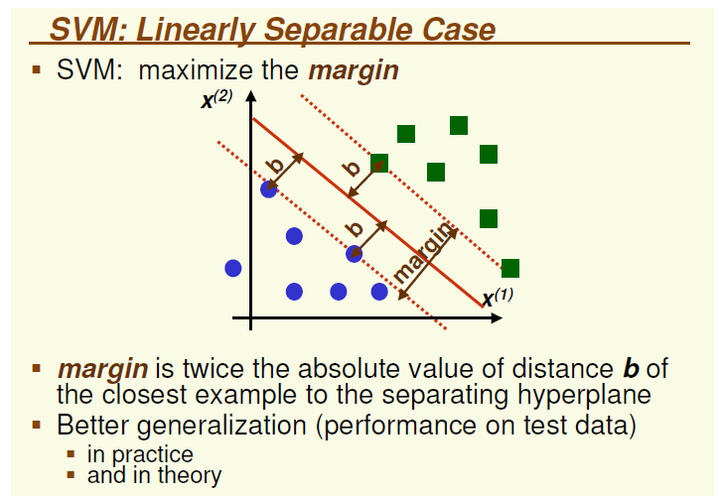

Slide 30
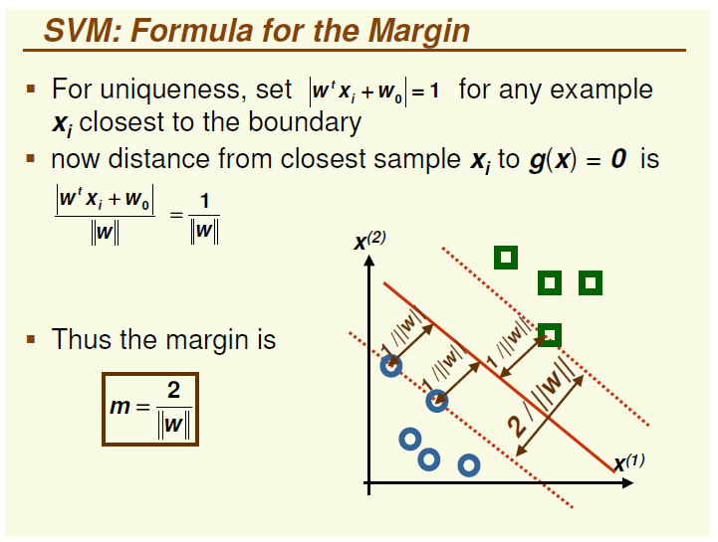

Slide 31

Margin
$m=\frac{2}{\left\|w\right\|}$
$w=(\frac{2}{5};\frac{4}{5}$)
$m=\frac{2}{\sqrt{{(\frac{2}{5})}^{2}+{(\frac{4}{5})}^{2}}}$
$m=$2.236

Slide 32
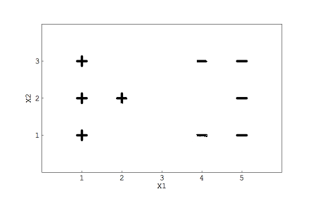
Exs

Slide 33
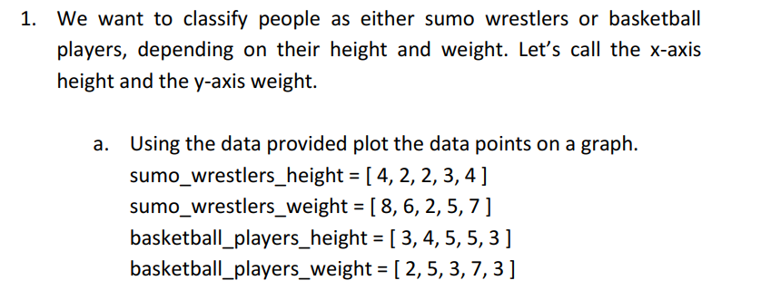
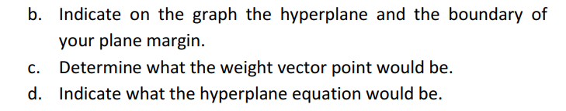
Exercise

Slide 34
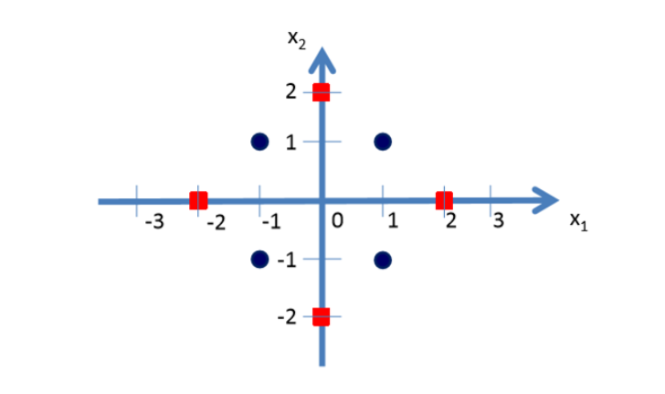
Non Linearly Separable
You might struggle to divide data linearly through a straight line, plane or hyperplane

Slide 35
Obviously there is no clear separating hyperplane between the red class and the blue class.

Slide 36
Classes
The blue class vectors are (1, 1), (-1, 1), (-1, -1) and (1, -1). The red class vectors are (2, 0), (0, 2), (-2, 0) and (0, -2).

Slide 37
Mapping function
Here we need to find a non-linear mapping function Φ which can transform these data in to a new feature space where a separating hyperplane can be found.
In order to do this we need to make use of functions.
Let us consider the following mapping function.

Slide 38
Mapping function Cont..
.

Slide 39

Mapping/ transforming
Now let us transform the blue and red class vectors using the non-linear mapping function Φ
The blue class vectors will remain the same since all $\sqrt{x_{1}^{2}+x_{2}^{2}}<2$

Slide 40

Transformation
Let us take the red class vectors (2, 0), (0, 2), (-2, 0) and
(0, -2) and since all of them will yield values greater than 2 for $\sqrt{x_{1}^{2}+x_{2}^{2}}$ ≥$2$

Slide 41
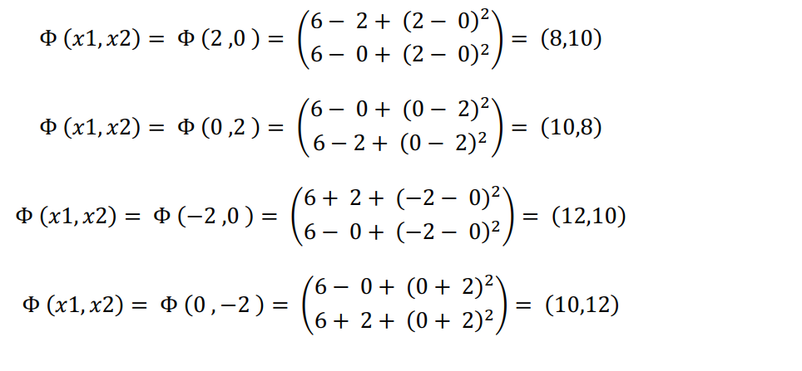
New Points

Slide 42
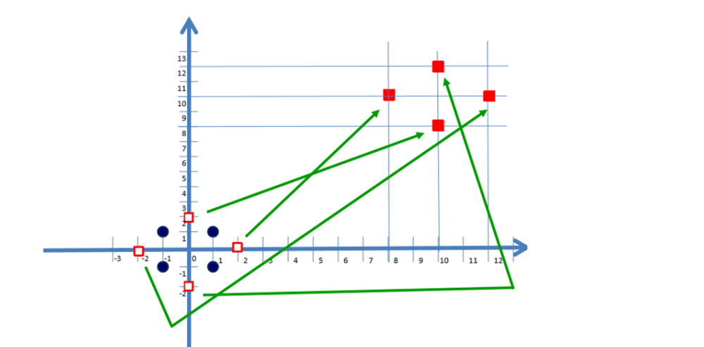
Transformed vectors

Slide 43
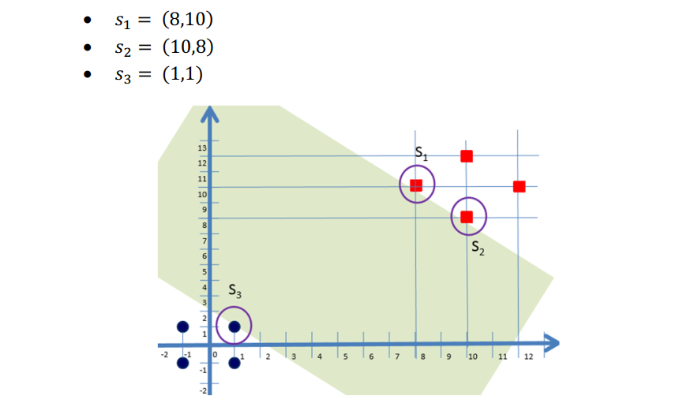
Support Vectors

Slide 44

Weight Vector
$W=a\left(\left(\begin{matrix}8 \\ 10\end{matrix}\right)−\left(\begin{matrix}1 \\ 1\end{matrix}\right)\right)$
$=\left(\begin{matrix}7a \\ 9a\end{matrix}\right)$
${\vec{w}}^{T}=\left(7a 9a\right)$

Slide 45

Substitute in the Hyperplane Function
$$\left(7a 9a\right)∗\left(\begin{matrix}x_{1} \\ x_{2}\end{matrix}\right)+ω_{0}=+1$$
$$\left(7a 9a\right)∗\left(\begin{matrix}x_{1} \\ x_{2}\end{matrix}\right)+ω_{0}=−1$$

Slide 46

Substitute
$$\left(7a 9a\right)∗\left(\begin{matrix}8 \\ 10\end{matrix}\right)+ω_{0}=+1$$
$$\left(7a 9a\right)∗\left(\begin{matrix}1 \\ 1\end{matrix}\right)+ω_{0}=−1$$

Slide 47

Solve simultaneously
$56a+90a+ω_{0}= 1$ ….. *
$7a+9a+ω_{0}=−1$ ……**
Simplifying each equation
$146a+ω_{0}= 1$ ….. ***
$16a+ω_{0}=−1$ ……****

Slide 48

Solve simultaneously
$$130a=2$$
$$a= \frac{2}{130}$$
$$a= \frac{1}{65}$$

Slide 49

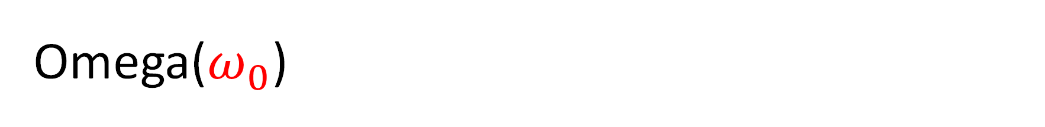
Omega($ω_{0}$)
$ω_{0}=1−146\left(\frac{1}{65}\right)$
$ω_{0}=−\frac{81}{65}$

Slide 50

Weight Vector
${\vec{w}}^{T}=\left(7\left(\frac{1}{65}\right) 9\left(\frac{1}{65}\right)\right)$
${\vec{w}}^{T}=\left( \frac{7}{65} \frac{9}{65}\right)$

Slide 51

The Hyperplane function
$g\left(\vec{x}\right)=\left( \frac{7}{65} \frac{9}{65}\right)∗\left(\begin{matrix}x_{1} \\ x_{2}\end{matrix}\right)+ −\frac{81}{65}$
$g\left(\vec{x}\right)=\frac{7}{65}x_{1}+ \frac{9}{65}x_{2} −\frac{81}{65}$
Since for the accurate hyperplane $g\left(\vec{x}\right)=0$
$g\left(\vec{x}\right)=7x_{1}+9x_{2} −81$

Slide 52
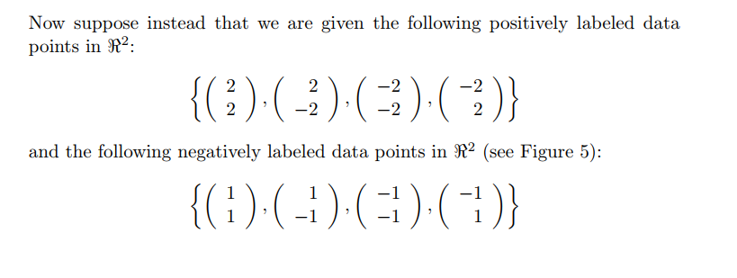
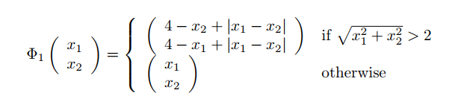
Exercise

Slide 53
